Slide 1




CSA0912-PROGRAMMING IN JAVA FOR ACCESSING DATABASE
Online Movie Ticket Booking System
Projected BY,
J . Harsha Vardhan Reddy(192210422)
CSE DEPARTMENT
SSE,SIMATS
Guided BY,
Mr.Dr . Jayasakthi Velmurugan K
(course faculty)
Java Programming
SSE,SIMATS

Slide 2

Introduction
The online movie ticket booking system aims to simplify the process of purchasing movie tickets for users. It eliminates the hassle of waiting in line and provides convenience and accessibility. This presentation will guide you through the system's key features and benefits.
1
User-Friendly Interface
2
Comprehensive Movie Database
The system features an intuitive and user-friendly interface that makes it easy to navigate.
The system offers a comprehensive database of movies, including information on showtimes, theaters, and seating availability.
3
Secure Payment Options
4
Real-Time Updates
The system provides multiple secure payment options for users to choose from.
The system provides real-time updates on movie availability, showtimes, and seating arrangements.

Slide 3
Agenda
This presentation will cover the following key areas related to the online movie ticket booking system.
Introduction
1
Overview of the system and its purpose.
2
Project Objective
Defining the goals and aims of the project.
Existing System Drawbacks
3
Identifying limitations of the current system.
4
Proposed System Advantages
Highlighting the benefits of the proposed system.
System Architecture
5
Explaining the technical design and components.
6
Module Description
Detailed overview of each system module.
Conclusion and Future Enhancement
7
Summarizing the presentation and outlining future development plans.

Slide 4
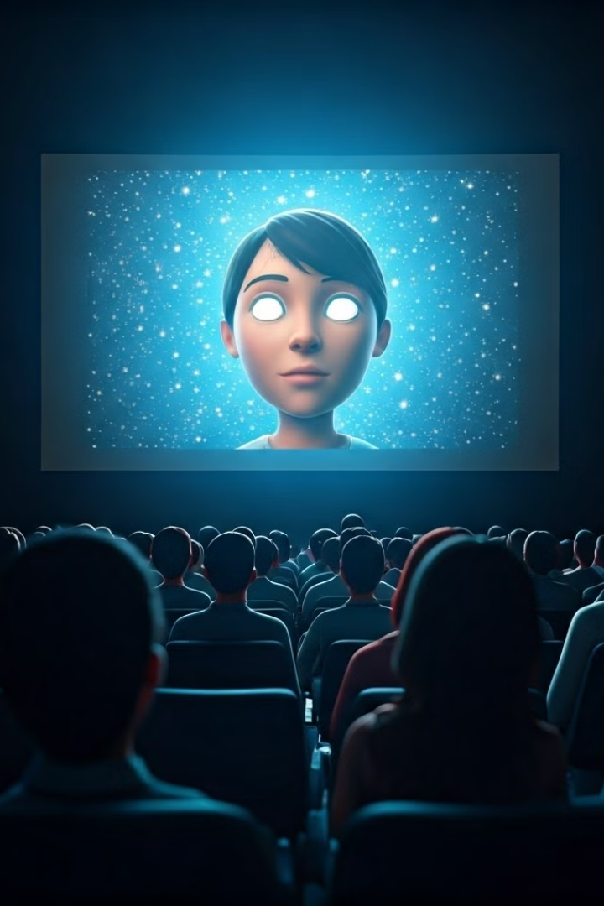
Objective of Your Project
The project aims to develop an online movie ticket booking system that provides users with a convenient, efficient, and secure way to purchase tickets for movies. The system should enhance the user experience, streamline the booking process, and provide real-time information about movie availability and showtimes.
Enhance User Experience
Streamline Booking Process
Provide a user-friendly and intuitive interface for easy navigation.
Simplify the ticket purchasing process by eliminating the need for physical queues.
Real-Time Information
Secure Payment Gateway
Offer up-to-date information on movie availability, showtimes, and seating arrangements.
Ensure secure and reliable payment processing for user transactions.

Slide 5
Existing System and Its Drawbacks
Many movie theaters still rely on traditional box office ticketing, which presents a number of drawbacks.
Long Queues
Limited Ticket Availability
Lack of Online Convenience
Long wait times can be frustrating for customers, especially during peak hours or popular movie releases.
Customers may be unable to purchase tickets for popular movies due to limited availability.
The inability to purchase tickets online restricts access to convenient booking options.

Slide 6





Proposed System and Its Advantages
The proposed online movie ticket booking system addresses the limitations of the existing system by offering a number of advantages.
24/7 Availability
Real-Time Availability
Secure Payment Options
Personalized Recommendations
Users can book tickets at any time of day or night, from anywhere with internet access.
The system provides real-time information on movie availability, showtimes, and seating arrangements.
The system offers various secure payment options for convenient and secure transactions.
The system can provide personalized movie recommendations based on user preferences.

Slide 7

Architecture Diagram
The architecture of the online movie ticket booking system is designed to ensure efficient and reliable operation. It consists of several interconnected components that work together to provide a seamless user experience.
Component
Description
User Interface
Provides a user-friendly platform for browsing movies, selecting showtimes, and purchasing tickets.
Database
Stores movie information, showtimes, seating availability, user data, and transaction history.
Payment Gateway
Handles secure payment processing and integration with multiple payment options.
Theater Integration
Connects with theater systems to retrieve real-time data on showtimes and seating availability.
Notification System
Sends notifications to users about booking confirmations, reminders, and other relevant updates.

Slide 8





Listed Modules
The online movie ticket booking system comprises various modules that work together to deliver the desired functionality.
User Management
Movie Management
Theater Management
Showtime Management
Manages user registration, login, profile management, and account settings.
Handles movie data, including titles, descriptions, genres, and release dates.
Manages theater information, including locations, screen layouts, and seating configurations.
Handles showtime scheduling, availability, and real-time updates.

Slide 9
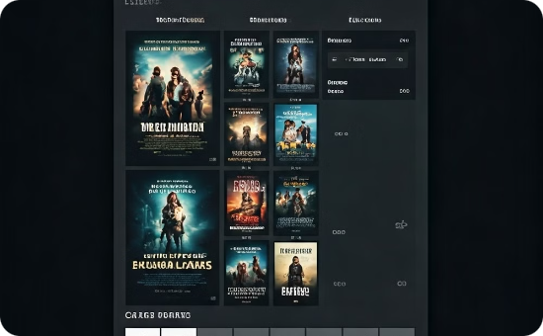
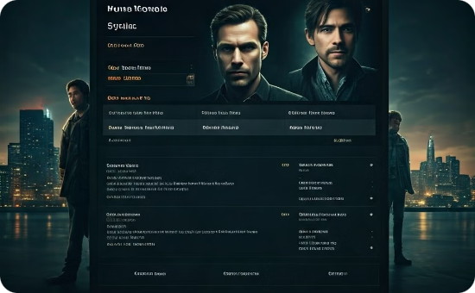
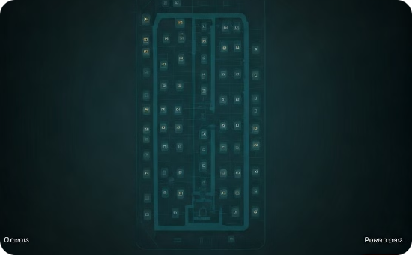
Each Module Description and Output Screenshot
Each module in the online movie ticket booking system plays a crucial role in delivering a seamless and enjoyable user experience.
Movie Listing
Movie Details
Seat Selection
The Movie Listing module displays a user-friendly list of movies with relevant details, allowing users to browse and select movies based on their preferences.
The Movie Details module provides comprehensive information about a selected movie, including synopsis, cast and crew, trailers, and user ratings.
The Seat Selection module presents a seating map with available and reserved seats, allowing users to choose their preferred seating arrangement for the selected movie and showtime.

Slide 10
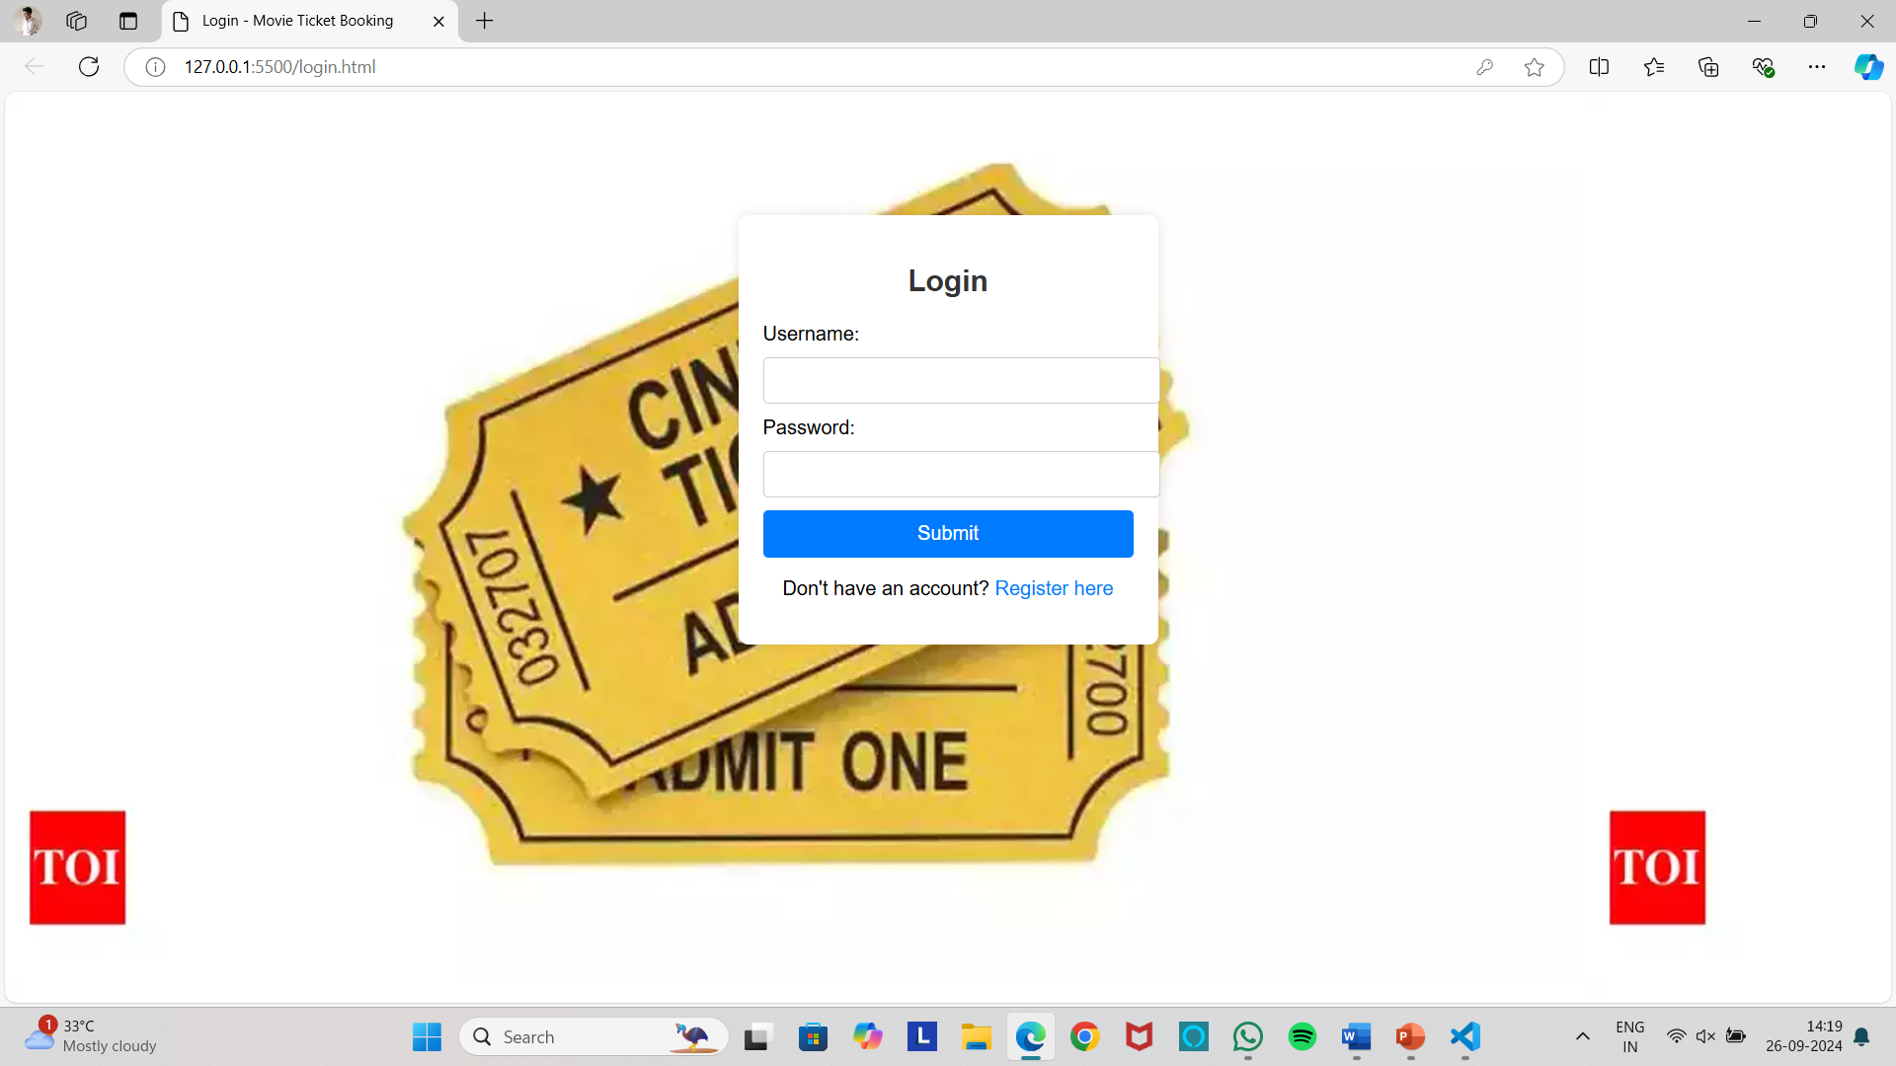
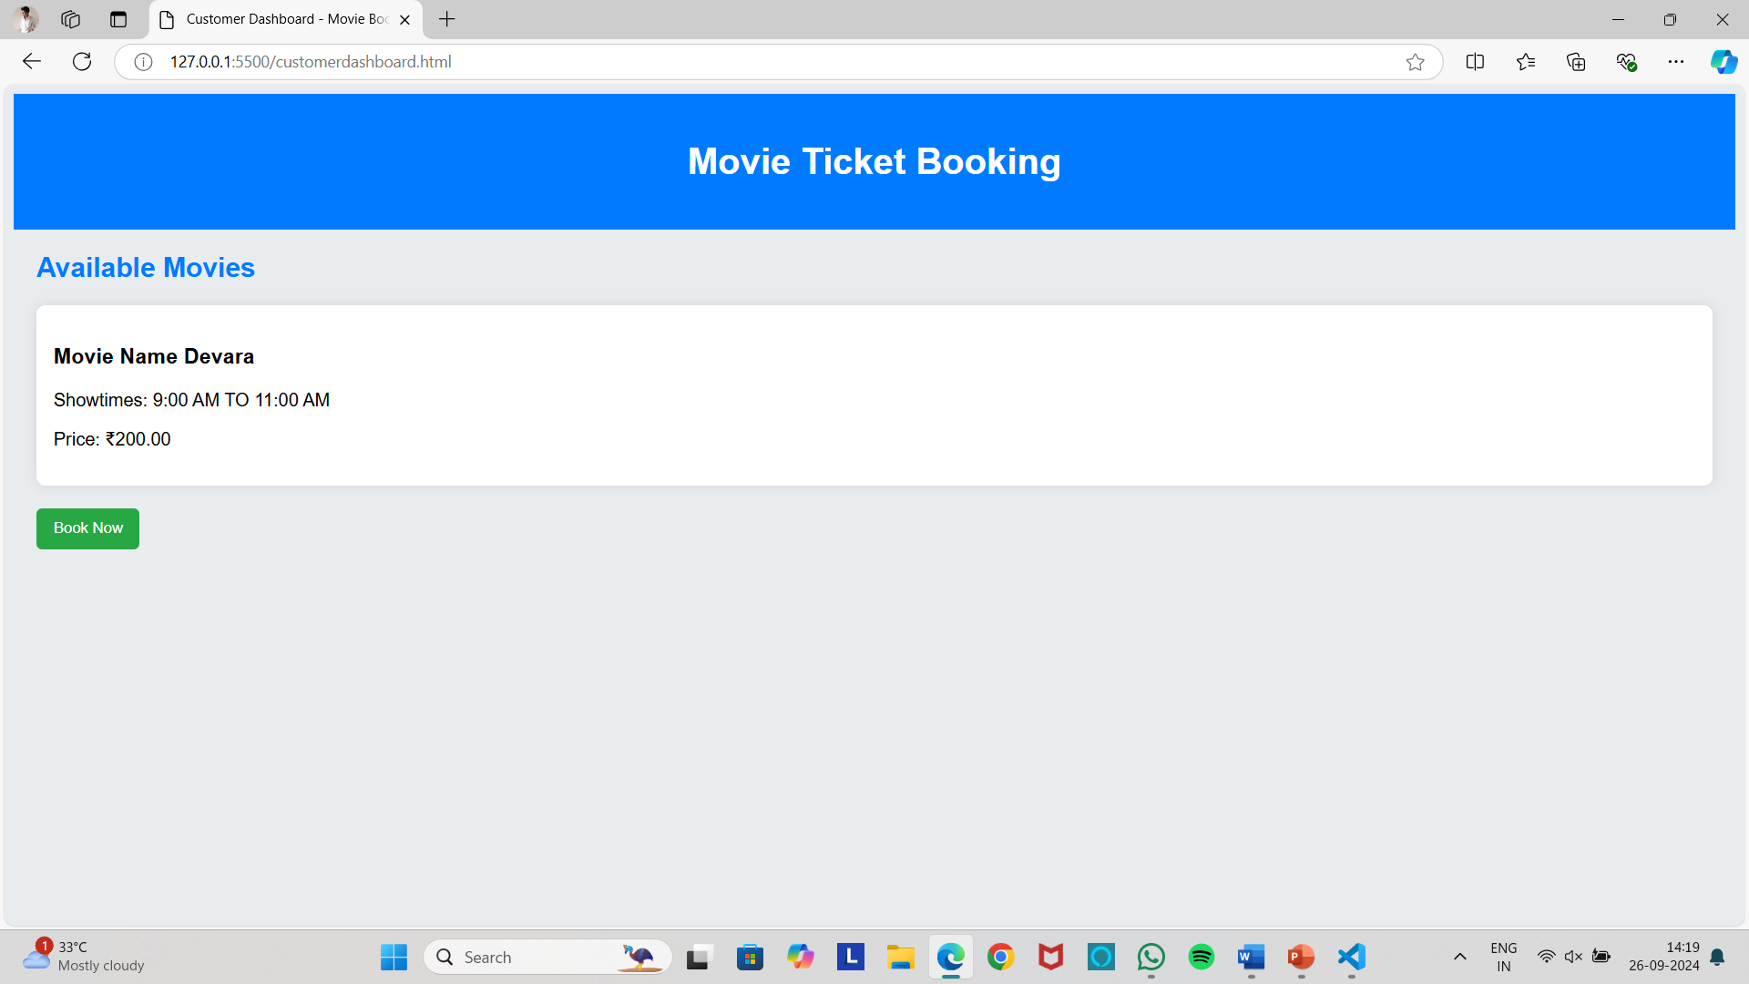
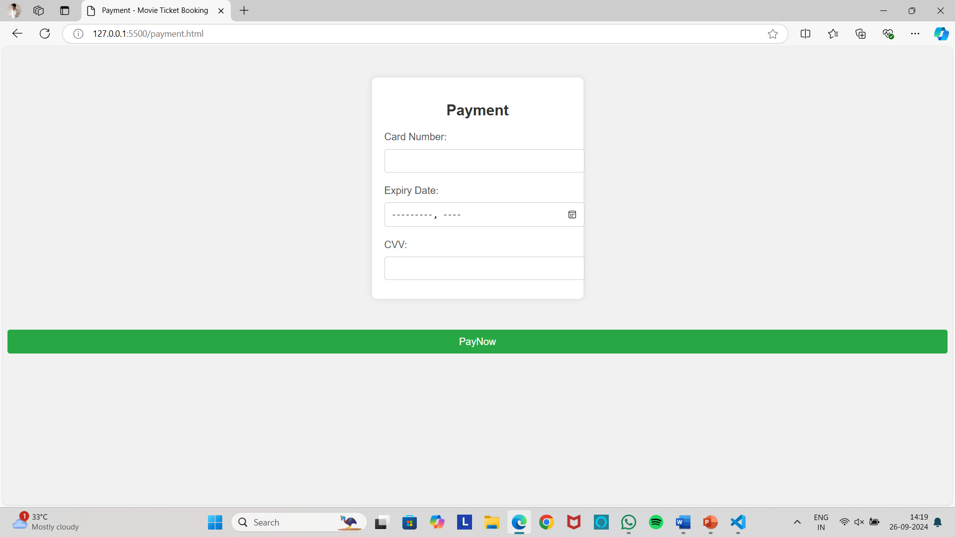
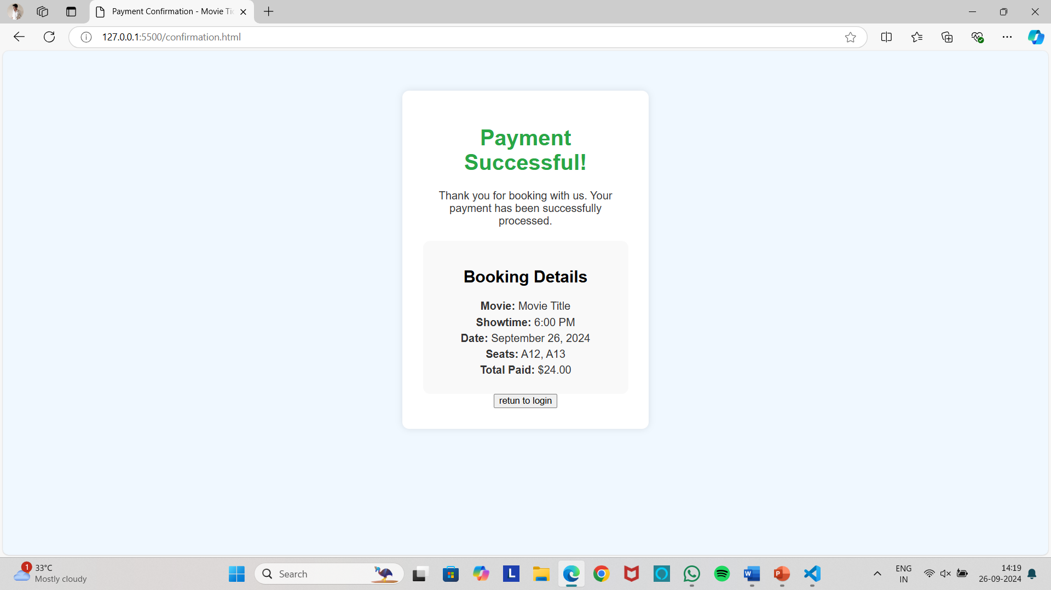

Slide 11
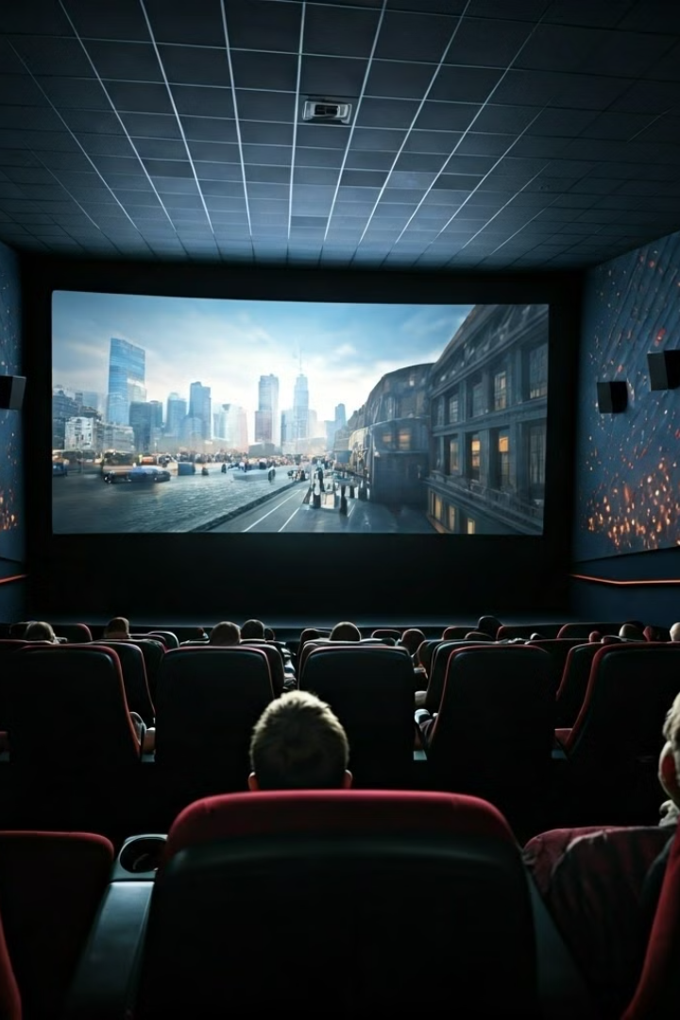
Conclusion and Future Enhancement
The online movie ticket booking system provides a convenient, efficient, and secure way for users to purchase tickets for movies.
Improved User Interface
Personalized Recommendations
Enhance the user interface with advanced features and interactive elements.
Implement an advanced recommendation engine to provide tailored movie suggestions.
Integration with Social Media
Mobile App Development
Develop a dedicated mobile app for enhanced accessibility and user convenience.
Integrate the system with social media platforms to allow users to share their movie experiences.

Slide 12


